Slide 1
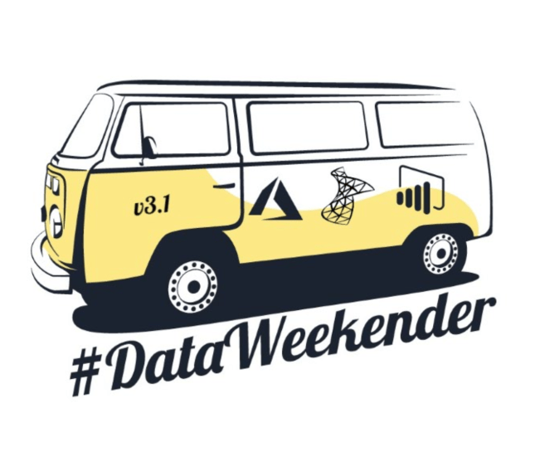
Automated provisioning of SQL Server VMs on Azure
3rd DataWeekender Online Conference
May 15 2021
Kay Sauter

Slide 2

Kay Sauter (He/Him)
Senior BI Consultant @ OneDigit AG
Working with data since 2008
SQL Server, PBIRS, SSAS and Azure
Has bionic ears (Cochlear Implants)
Traveller
From Zurich, Switzerland

Slide 3
Questions?
Blog kayondata.com | onedigit.ch
@kaysauter
kay@kayondata.com | kay.sauter@onedigit.ch
linkedin.com/in/kaysauter
github.com/kaysauter
Code will be on github
Notes:
If you have any questions after the presentation, feel free to contact me through one of those channels

Slide 4



Goals 🎯
Create a VM on Azure with PowerShell
Secure connection to VM via TSL/SSL
Install SW on VM via PowerShell
Insights into Pricing 💶
Notes:
Other options like Chef, Ansible etc. are not by Microsoft
This solution focuses on rather simple deployments for few VMs

Slide 5
Agenda
Why 🤔
Architecture 🏛
Security 🔐
Code and tools 💻
Demo ⚗
Pricing 💶

Slide 6

Why automate VM deployments?
Always have same setup easily
DEV ENV that can be deleted if needed
Testing
Showcasing (eg. via Azure Labs)
A way to save costs
PowerShell, native tool provided by Microsoft

Slide 7
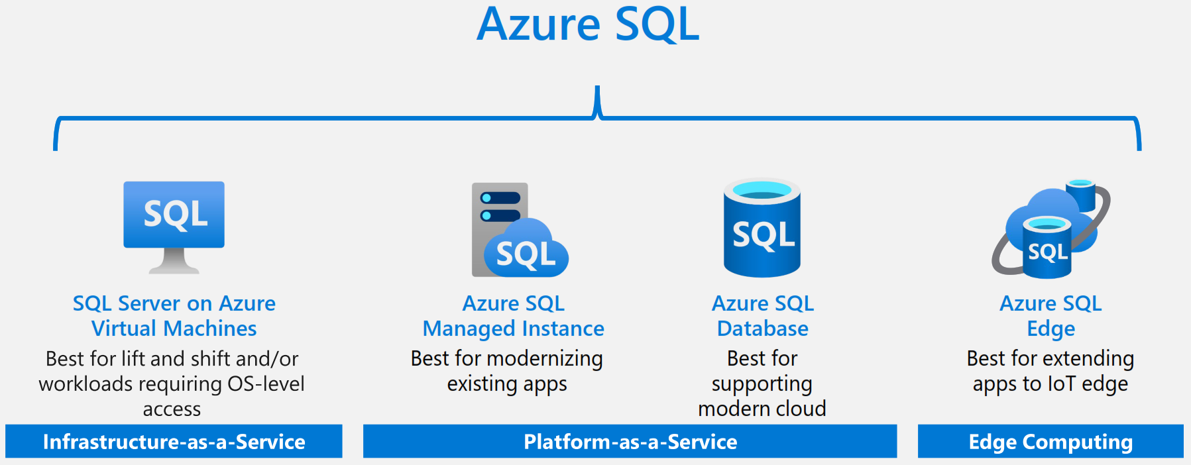
Overview on Azure Platform
Notes:
Source: https://azure.microsoft.com/en-us/resources/get-to-know-azure-sql/

Slide 8
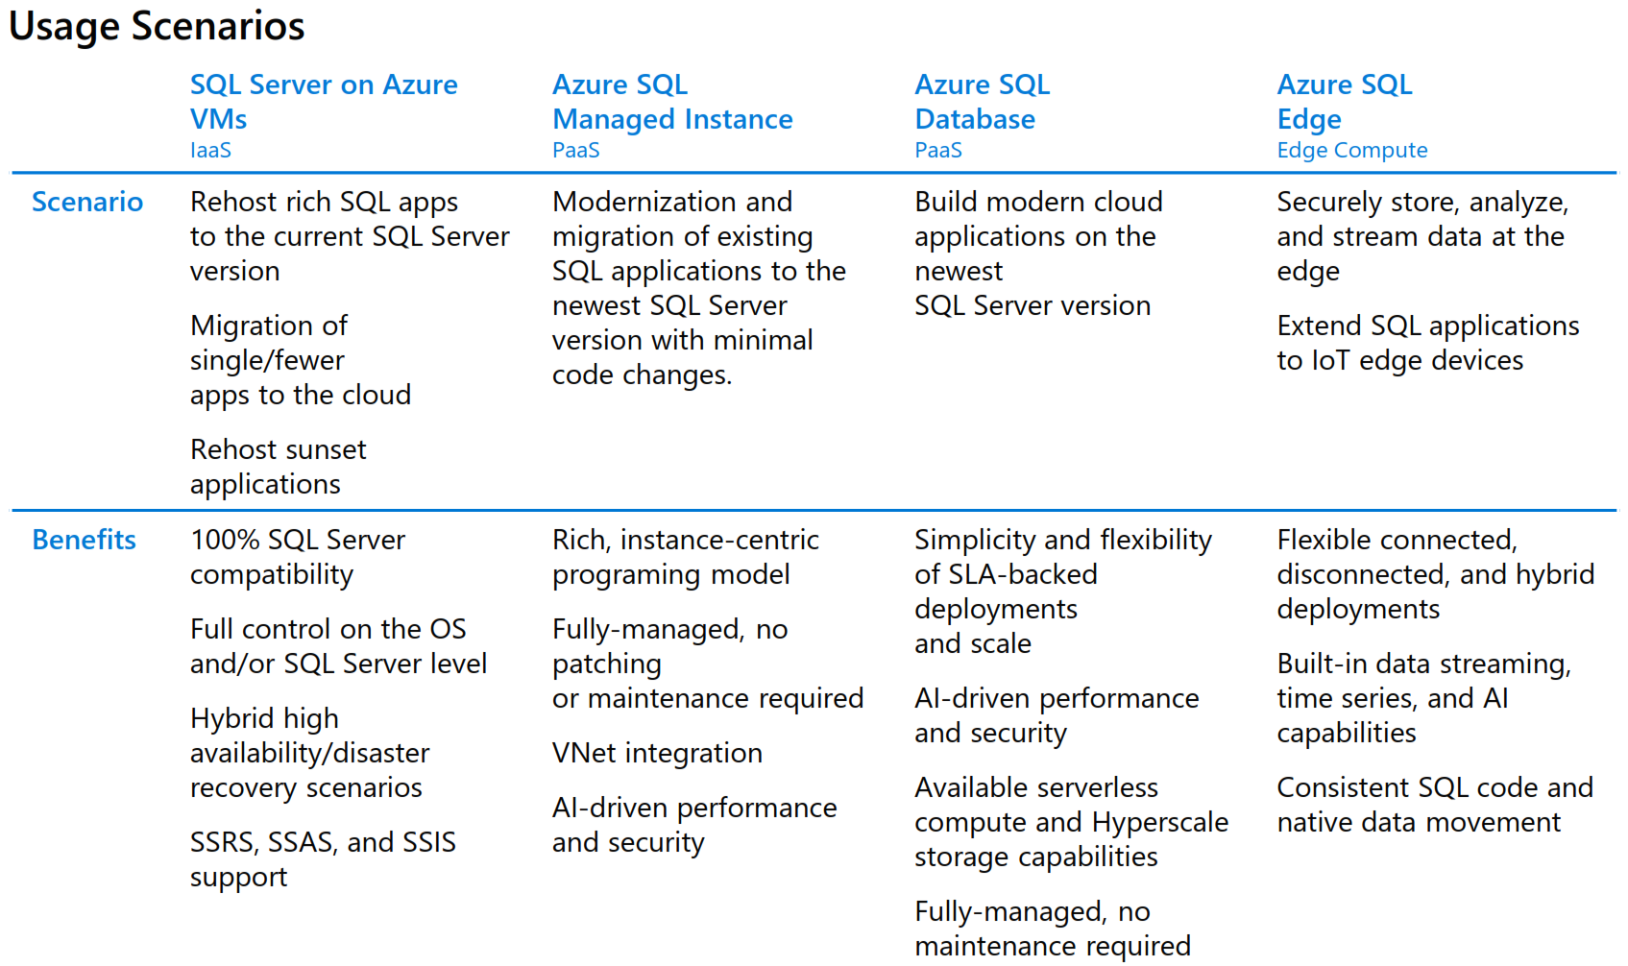
Overview on Azure Platform
Notes:
Because you have full control on VMs, compliance with regulatory reasons can be easier
Still ideal for complex data warehouses
For swiss banking and finance industry, often preferred because for full datawarehouse solutions, still most capabilities
Source: https://azure.microsoft.com/en-us/resources/get-to-know-azure-sql/

Slide 9
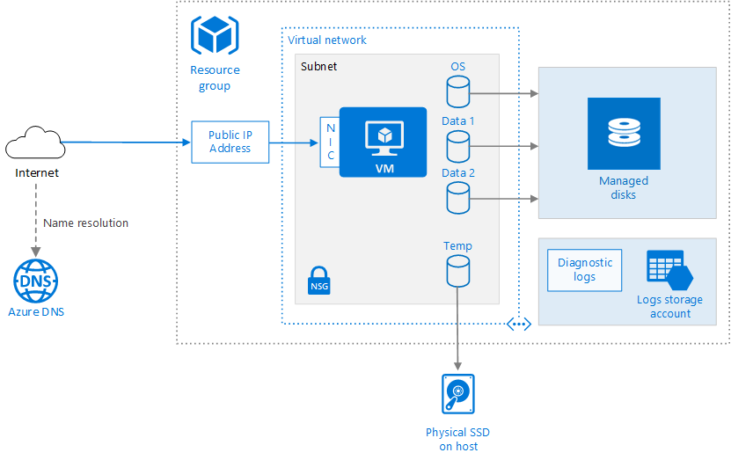
Base Architecture for VM
Notes:
Source: https://docs.microsoft.com/en-us/azure/architecture/reference-architectures/n-tier/windows-vm

Slide 10

Azure Storage Explorer
Backup files upload via Drag & Drop
https://azure.microsoft.com/en-us/features/storage-explorer/
Azure File Storage will be mapped on VM as Z:\ with PowerShell

Slide 11
Azure File Storage
File storage with backups of databases
File storage is way cheaper than VM storage
For multiple VMs, you can have one central storage

Slide 12

RDP over Internet is risky!
RDP over internet should always encrypted
https://www.microsoft.com/security/blog/2020/04/16/security-guidance-remote-desktop-adoption/
Notes:
Prone to port scans and potential DDOS risks
https://www.microsoft.com/security/blog/2020/04/16/security-guidance-remote-desktop-adoption/

Slide 13
Azure Bastion for security
Azure Bastion is easy to set up
End-to-End VPN from Azure to Company is possible, but not easy
Works with a browser, RDP gets tunneled with SSL
Public IP address is not exposed

Slide 14
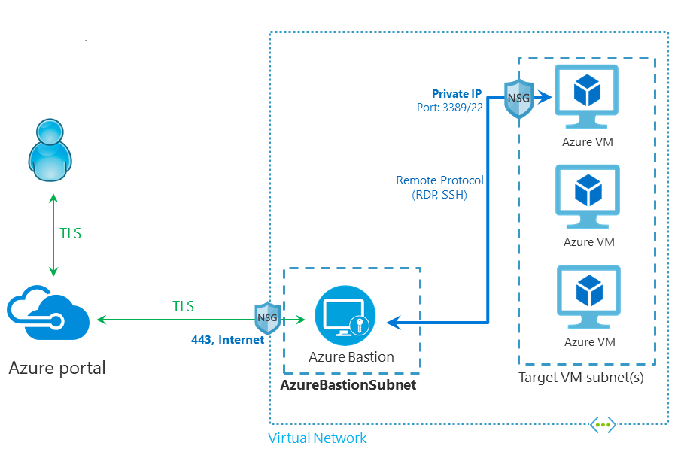
Architecture Azure Bastion
Notes:
Architecture for Azure Bastion.
NSG = Network Security Group
Source: https://docs.microsoft.com/en-us/azure/bastion/bastion-overview

Slide 15
CODE
github.com/kaysauter

Slide 16
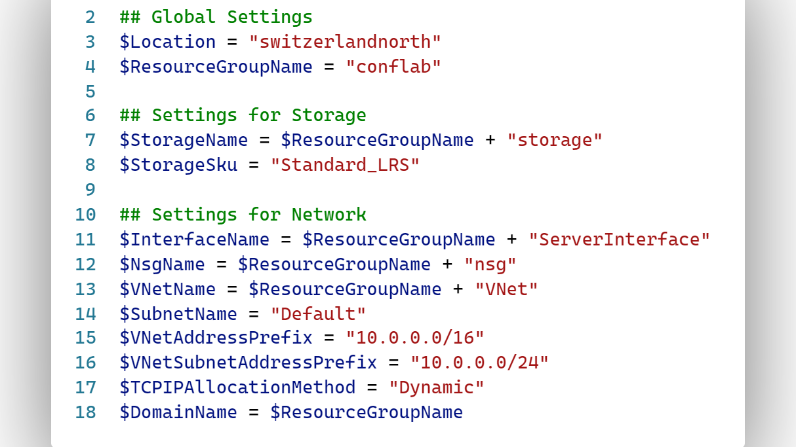

Slide 19
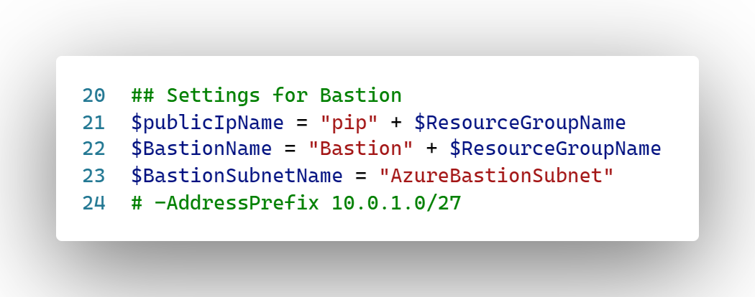

Slide 20
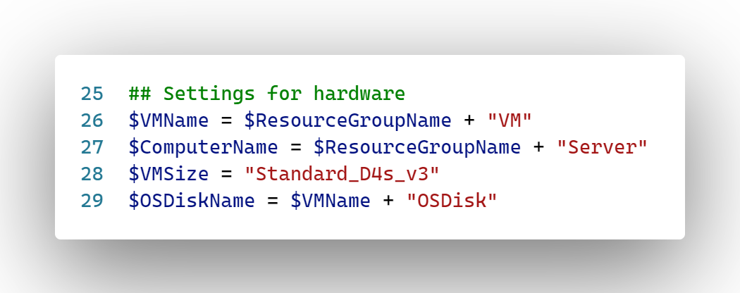

Slide 21
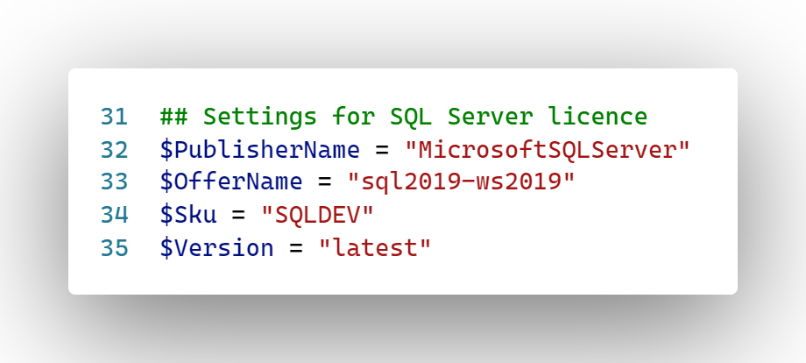
Notes:
This is the VM provided by Microsoft
SQLDEV means it is the SQL Server DEV Edition which is licensed for non production purposes

Slide 22
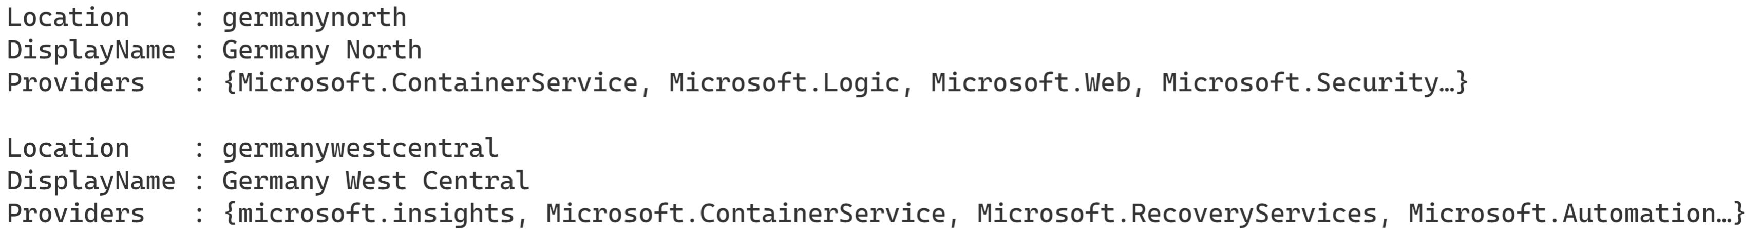

Slide 23
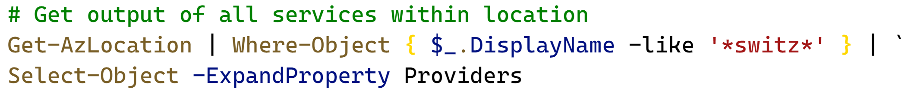
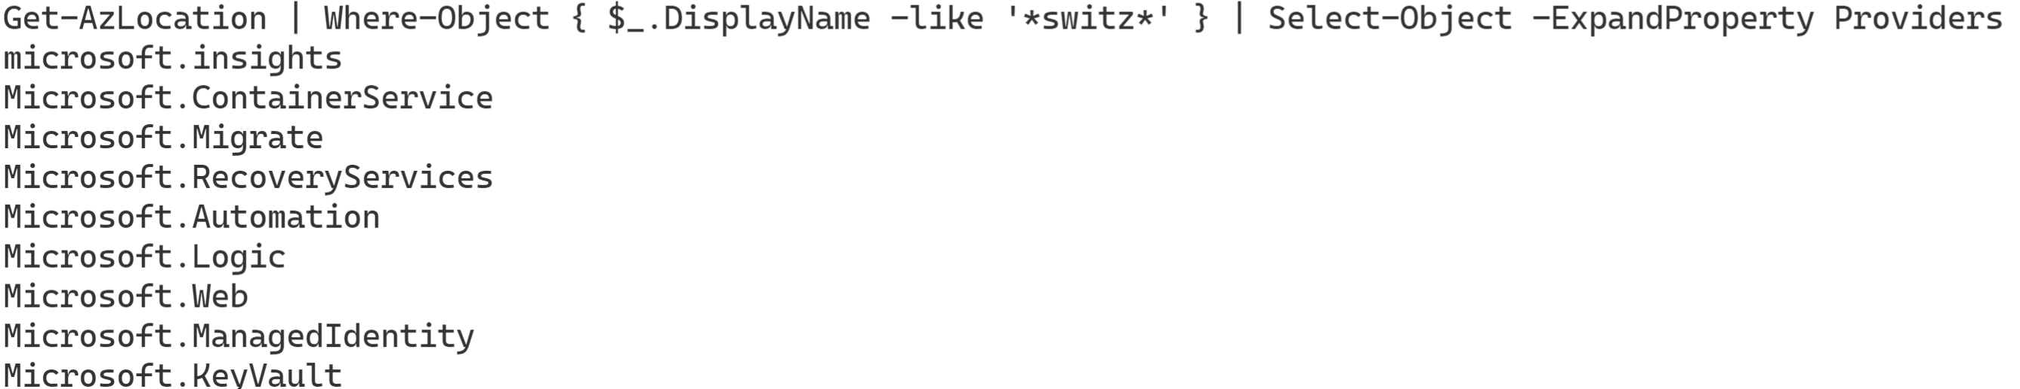

Slide 24
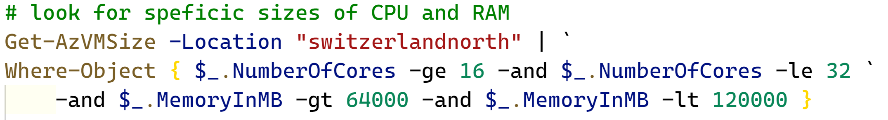
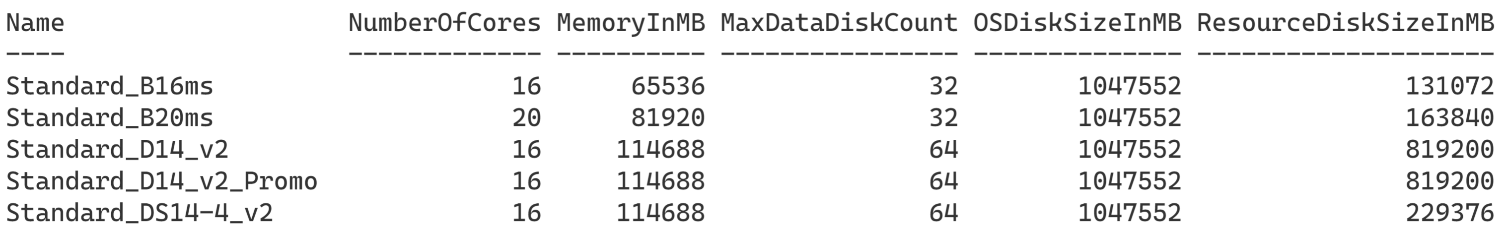

Slide 25
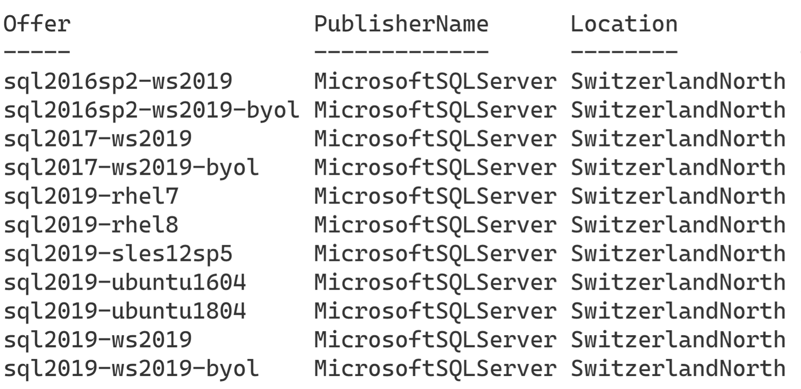

Slide 26
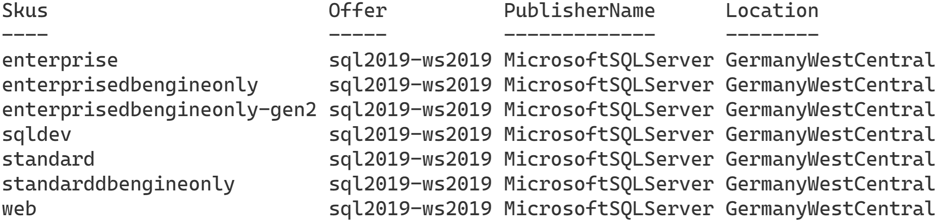

Slide 27

Chocolatey
Bases on PowerShell
Commercial software but has a opensource & free version which is going to be used for this demo
Can download and install software automatically
Is secure because it does also check checksums before installation of downloaded software
Notes:
https://chocolatey.org/

Slide 28
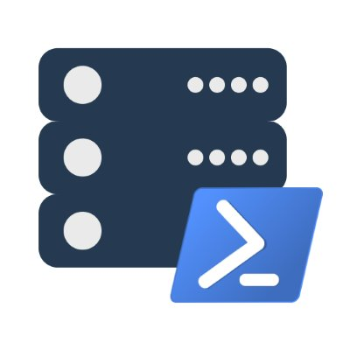
dbatools
«SSMS via PowerShell»
Open Source and free, code on GitHub
Created by Chrissy LeMaire and maintained by her with Jess Pomfret and Shawn Melton
Very powerful and easy to use
Notes:
Dbatools.io

Slide 29
Automation On / Off VM
It is possible to tell Azure to power off a VM at a given time
It is also possible to start a vm on given days/time
You can save money that way

Slide 30
Backup & restore
Backup of VMs is possible
Backup for securing data
Restore is takes a few mins
Can be done in PowerShell

Slide 31
DEMO

Slide 32
Pricing 💶
Rather complex
Pricing types:
Pay as you go
Reserved Virtual Machine Instances
Spot pricing
BYOL: Bring Your Own License

Slide 33
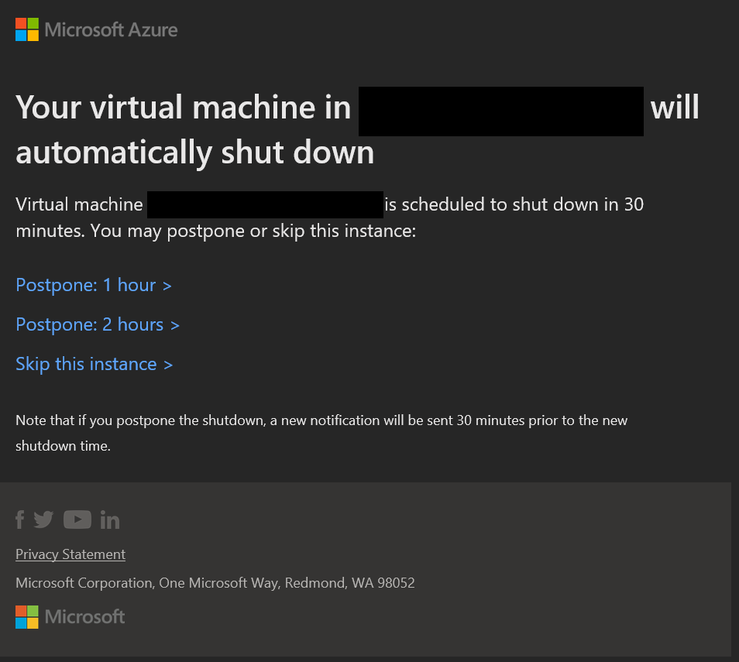
Pricing 💶
If a VM is shut down, it costs less because no CPU / RAM used
You can automate Shut-Downs, eg. 19:00 with Email-Warnings with possibility to postpone
Notes:
In the right, you see a screenshot of an email with which you can postpone the shut-down by clicking on one of these links.

Slide 34
Pricing 💶
You can scale up / scale down a VM which also impacts pricing

Slide 35
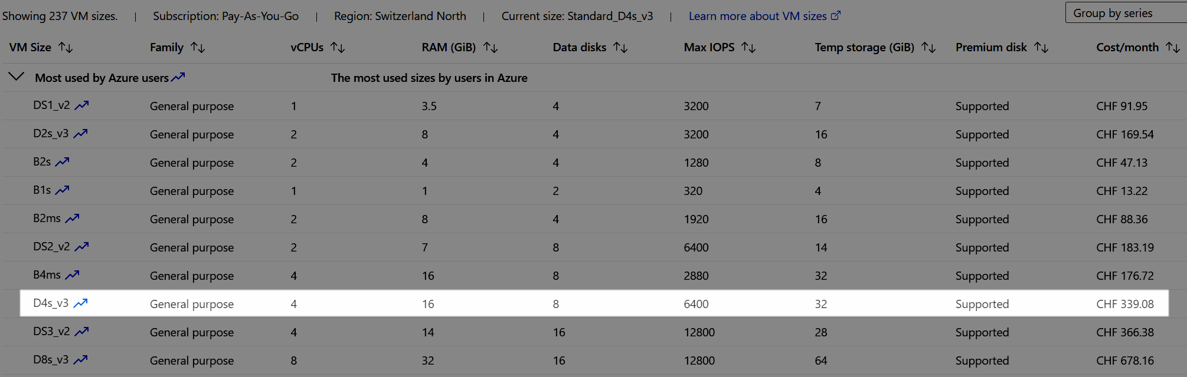
Pricing Example
File store size: 5 TB
Notes:
Microsoft has a catalog of different VMs you can choose from
They differ in their hardware builds, for example better or weaker CPU / RAM / Harddisk options
The more Ram / CPU you need, the expensive it gets

Slide 36
Real Example Month April for a Test ENV
Cost breakdown in EUR
Cost breakdown in %
Notes:
Use case @ OneDigit AG
Cost total 138 Eur

Slide 37
Recap
Almost fully automated provisoning only with PowerShell of VMs with SQL Server and restored databases is possible
Solution uses an approach from desktop via PowerShell
Chocolatey and dbatools are great helpers

Slide 38
Questions?
OneDigit AG, onedigit.ch
Blog kayondata.com
@kaysauter
kay@kayondata.com
linkedin.com/in/kaysauter
github.com/kaysauter
Notes:
Feel free to contact me!

